Slide 1
Nuclear meltdown: a hazard evaluated using statistical learning techniques
He, Bowen
Department of Civil and Environmental Engineering, Vanderbilt University

Slide 2
Contents
1. Motivation
2. Introduction
3. Predictors
4. Data
5. Logistic Regression
6. Linear Discriminant Regression
7. Conclusion

Slide 3
Motivation
(1) Nuclear meltdown is the most common type of accident in the nuclear industry. It can produce numerous hazards to both environment and people.
(2) Example: Chernobyl, Three mile Island Accident, Fukushima nuclear accident.
(3) Studies show that Fukushima disaster is preventable.
(4) Is it possible to indicate the probability of the occurrence for a single nuclear reactor based on its inner and outer factors?

Slide 4
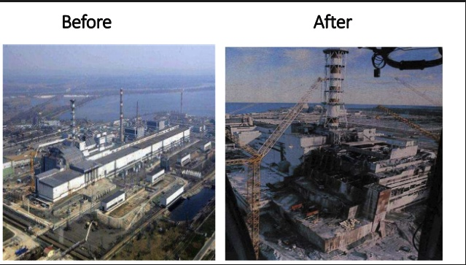
Chernobyl disaster

Slide 5
Predictors: inner and external factors
Inner factors: inner attributes of the nuclear reactor which include:
(1) Design capacity;
(2) Nuclear core design: active core height, active core diameter;
(3) Nuclear fuel type;
(4) The coolant type;
(5) The moderator type;
External factors: not related to the inner design of the reactor which include:
(1) Location;
(2) Human factor;

Slide 6
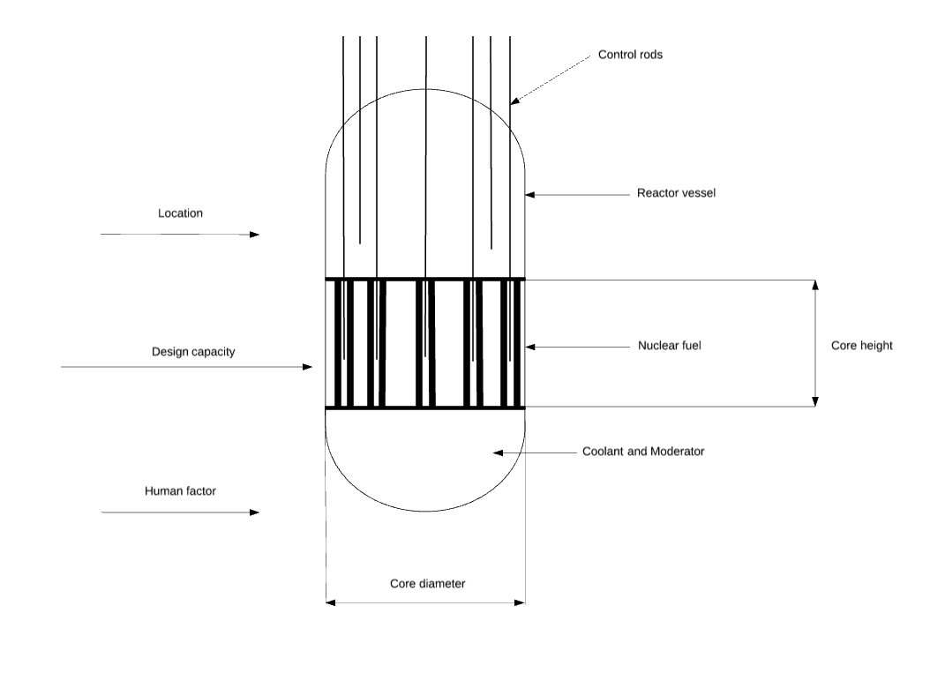
Scope of this study

Slide 7
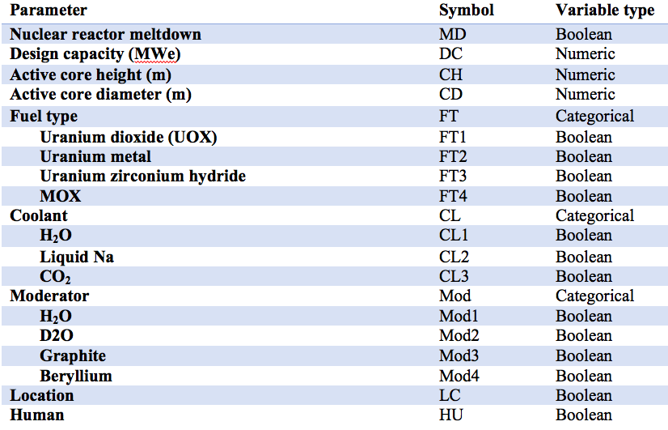
Data

Slide 8
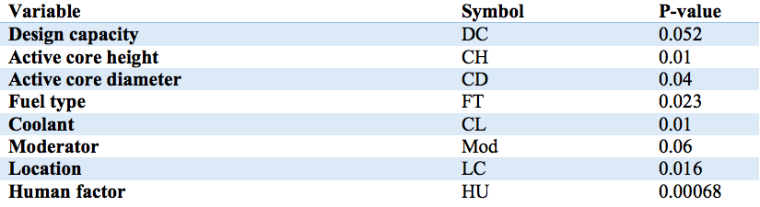
Independent variables and significance levels

Slide 9
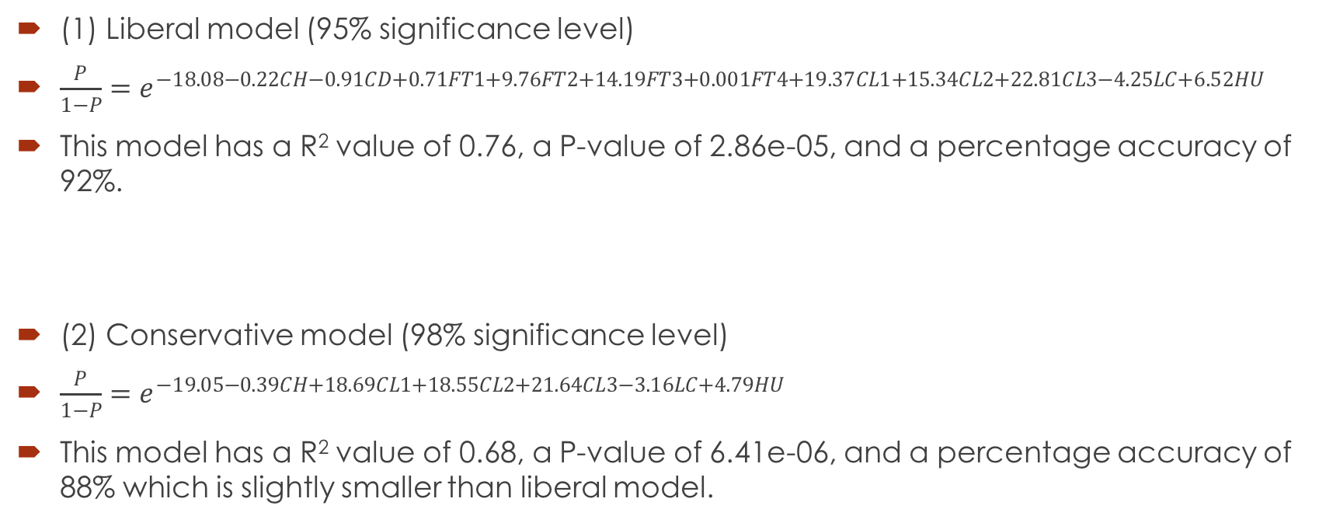
Logistic Regression
(1) Liberal model (95% significance level)
$\frac{P}{1−P}=e^{−18.08−0.22CH−0.91CD+0.71FT1+9.76FT2+14.19FT3+0.001FT4+19.37CL1+15.34CL2+22.81CL3−4.25LC+6.52HU}$
This model has a R² value of 0.76, a P-value of 2.86e-05, and a percentage accuracy of 92%.
(2) Conservative model (98% significance level)
$\frac{P}{1−P}=e^{−19.05−0.39CH+18.69CL1+18.55CL2+21.64CL3−3.16LC+4.79HU}$
This model has a R² value of 0.68, a P-value of 6.41e-06, and a percentage accuracy of 88% which is slightly smaller than liberal model.

Slide 10
Linear discriminant model
(1) Liberal model (95% significance level)
Predictors | LD1
CH | 0.13
CD | 0.16
FT1 | -1.14
FT2 | -2.02
FT3 | -1.49
FT4 | -0.24
CL1 | -2.53
CL2 | -2.25
CL3 | -4.44
LC | 1.00
HU | -2.12

Slide 11
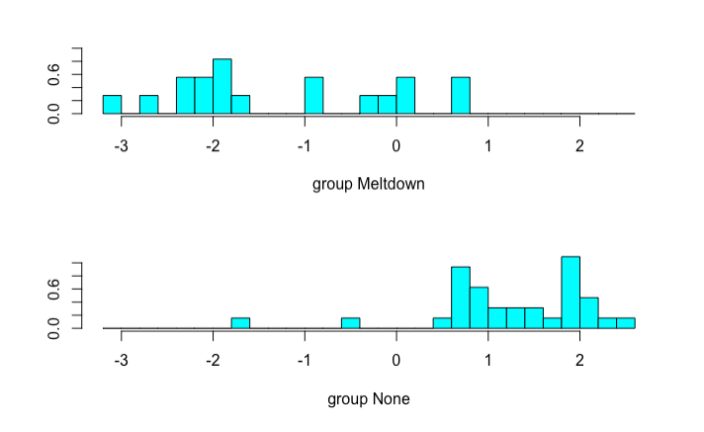
Linear discriminant model

Slide 12
Linear discriminant model
(2) Conservative model (98% significance level)
Predictors | LD1
CH | 0.198
CL1 | -2.75
CL2 | -2.92
CL3 | -4.33
LC | 1.00
HU | -2.25

Slide 13
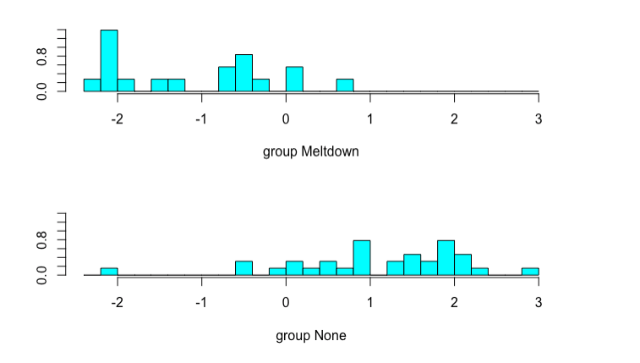
Linear discriminant model

Slide 14
Conclusion
(1) External factors play the major role.
(2) Logistic regression’s performance is better than Linear Discriminant Analysis.
(3) There are uncertainties associated with the analysis process.
(4) Nuclear meltdown accidents are usually the production of the combination of the design interior and the human error.
(5) Lesson learned in nuclear industry?

